Slide 1
License Plate Recognition
BCSE355L AWS Solutions Architect

Slide 2








AWS
Services
used
Storage
Backend
Amazon S3
Amazon DynamoDB
Amazon Lambda
Amazon IAM
Amazon API Gateway
ML
Debugging
Amazon Rekognition
Frontend
Amazon CloudWatch
Amazon Amplify

Slide 3
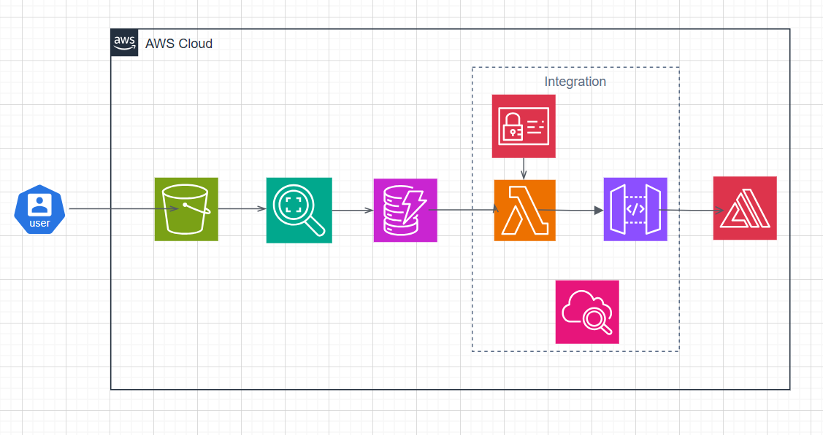
System Architecture Diagram

Slide 4
Data flow in Architecture Diagram
01
02
03
04
05
06
S3
Rekognition
DynamoDB
Image gets uploaded to S3 bucket
Text Extracted from Image
Extracted information stored in a table
Lambda, IAM
API Gateway
Amplify
Defines the data flow to and from S3 bucket, Rekognition module & table
Triggers Lambda Function
Deploys and hosts the user interface

